Slide 1
Divide-and-Conquer
The most-well known algorithm design strategy:
Divide instance of problem into two or more smaller instances
Solve smaller instances recursively
Obtain solution to original (larger) instance by combining these solutions
A. Levitin “Introduction to the Design & Analysis of Algorithms,” 3rd ed., Ch. 5 ©2012 Pearson Education, Inc. Upper Saddle River, NJ. All Rights Reserved.

Slide 2
Divide-and-Conquer Technique (cont.)
a problem of size n
subproblem 1
of size n/2
subproblem 2
of size n/2
a solution to
subproblem 1
a solution to
subproblem 2
a solution to
the original problem
A. Levitin “Introduction to the Design & Analysis of Algorithms,” 3rd ed., Ch. 5 ©2012 Pearson Education, Inc. Upper Saddle River, NJ. All Rights Reserved.

Slide 3
Divide-and-Conquer Examples
Sorting: mergesort and quicksort
Binary tree traversals
Multiplication of large integers
Matrix multiplication: Strassen’s algorithm
Closest-pair and convex-hull algorithms
Binary search: decrease-by-half (or degenerate divide&conq.)
A. Levitin “Introduction to the Design & Analysis of Algorithms,” 3rd ed., Ch. 5 ©2012 Pearson Education, Inc. Upper Saddle River, NJ. All Rights Reserved.

Slide 4
General Divide-and-Conquer Recurrence
T(n) = aT(n/b) + f (n) where f(n) ∈ Θ(n^{d}), d ≥ 0
Master Theorem: If a < b^{d}, T(n) ∈ Θ(n^{d})
If a = b^{d}, T(n) ∈ Θ(n^{d} log n)
If a > b^{d}, T(n) ∈ Θ(n^{log b a} )
Note: The same results hold with O instead of Θ.
Examples: T(n) = 4T(n/2) + n ⇒ T(n) ∈ ?
T(n) = 4T(n/2) + n² ⇒ T(n) ∈ ?
T(n) = 4T(n/2) + n³ ⇒ T(n) ∈ ?
A. Levitin “Introduction to the Design & Analysis of Algorithms,” 3rd ed., Ch. 5 ©2012 Pearson Education, Inc. Upper Saddle River, NJ. All Rights Reserved.

Slide 5
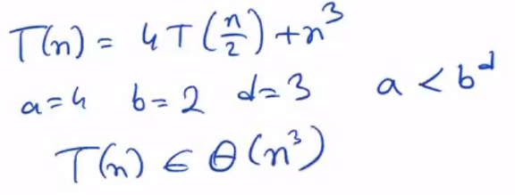
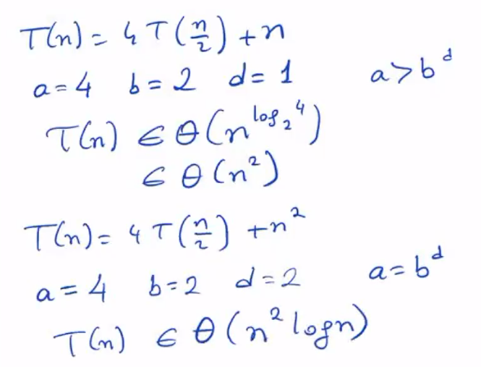
General Divide-and-Conquer Recurrence
T(n) = 4T(n/2) + n ⇒ T(n) ∈ ?
T(n) = 4T(n/2) + n² ⇒ T(n) ∈ ?
T(n) = 4T(n/2) + n³ ⇒ T(n) ∈ ?
A. Levitin “Introduction to the Design & Analysis of Algorithms,” 3rd ed., Ch. 5 ©2012 Pearson Education, Inc. Upper Saddle River, NJ. All Rights Reserved.

Slide 6
Mergesort
Split array A[0..n-1] in two about equal halves and make copies of each half in arrays B and C
Sort arrays B and C recursively
Merge sorted arrays B and C into array A as follows:
  Repeat the following until no elements remain in one of the arrays:
    compare the first elements in the remaining unprocessed portions of the arrays
    copy the smaller of the two into A, while incrementing the index indicating the unprocessed portion of that array
  Once all elements in one of the arrays are processed, copy the remaining unprocessed elements from the other array into A.
A. Levitin “Introduction to the Design & Analysis of Algorithms,” 3rd ed., Ch. 5 ©2012 Pearson Education, Inc. Upper Saddle River, NJ. All Rights Reserved.

Slide 7
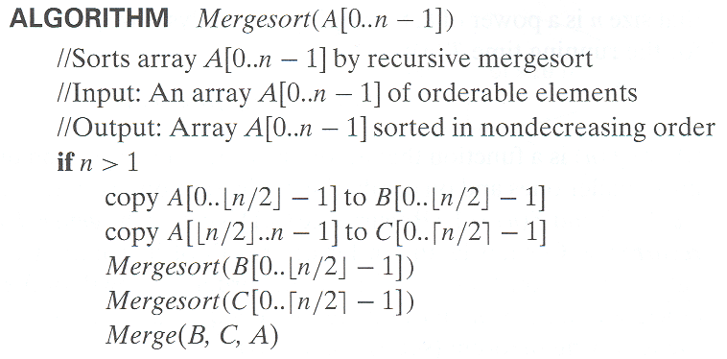
Pseudocode of Mergesort
A. Levitin “Introduction to the Design & Analysis of Algorithms,” 3rd ed., Ch. 5 ©2012 Pearson Education, Inc. Upper Saddle River, NJ. All Rights Reserved.

Slide 8
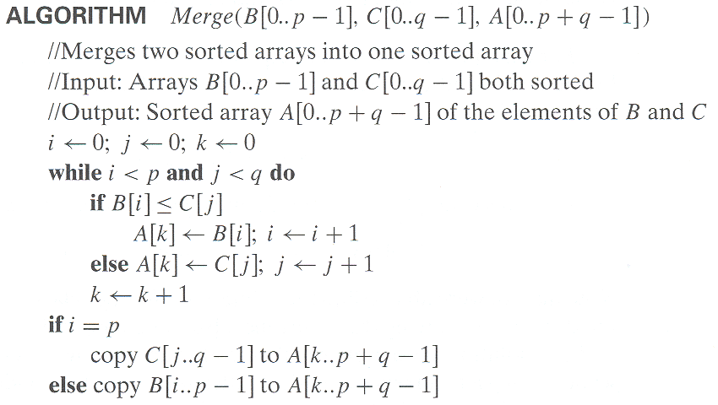
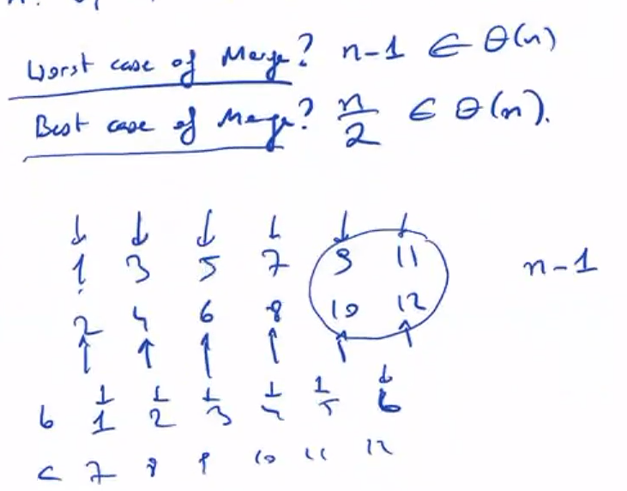
Pseudocode of Merge
A. Levitin “Introduction to the Design & Analysis of Algorithms,” 3rd ed., Ch. 5 ©2012 Pearson Education, Inc. Upper Saddle River, NJ. All Rights Reserved.

Slide 9
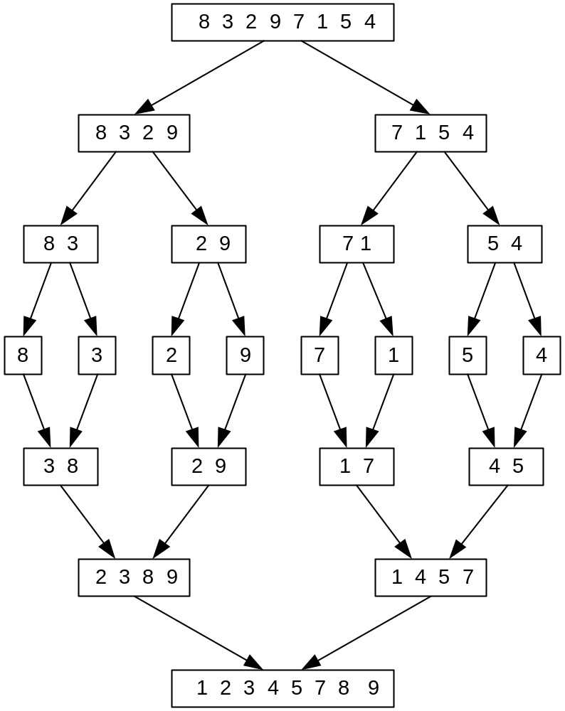
Mergesort Example
A. Levitin “Introduction to the Design & Analysis of Algorithms,” 3rd ed., Ch. 5 ©2012 Pearson Education, Inc. Upper Saddle River, NJ. All Rights Reserved.
Notes:
Go over this example in detail, then do another example of merging, something like:
(1 2 5 7 9)
(3 4 6)

Slide 10
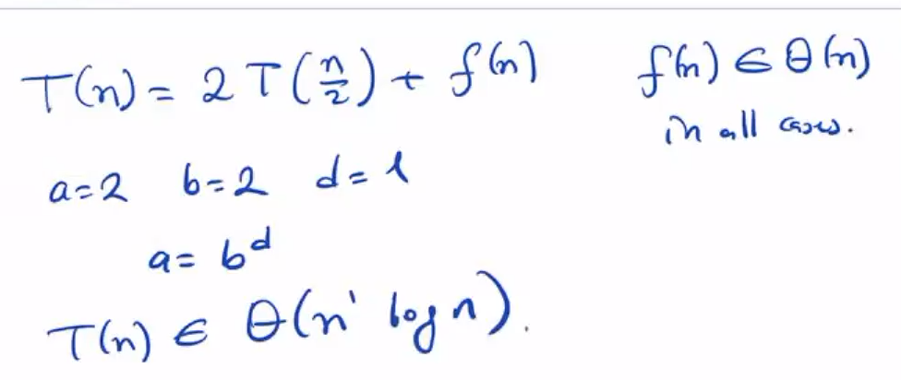
Analysis of Mergesort
All cases have same efficiency: Θ(n log n)
Number of comparisons in the worst case is close to theoretical minimum for comparison-based sorting:
  ⎡log₂ n!⎤ ≈ n log₂ n - 1.44n
Space requirement: Θ(n) (not in-place)
Can be implemented without recursion (bottom-up)
A. Levitin “Introduction to the Design & Analysis of Algorithms,” 3rd ed., Ch. 5 ©2012 Pearson Education, Inc. Upper Saddle River, NJ. All Rights Reserved.
Notes:
even if not analyzing in detail, show the recurrence for mergesort in worst case:
T(n) = 2 T(n/2) + (n-1)
worst case comparisons for merge

Slide 11
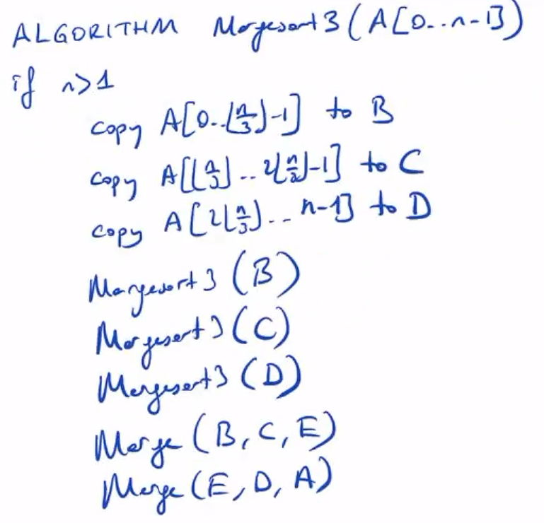
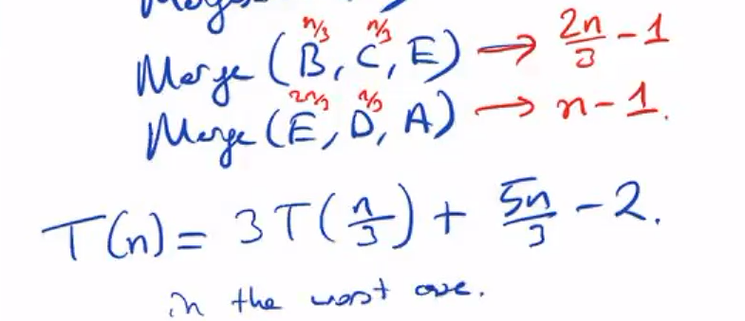

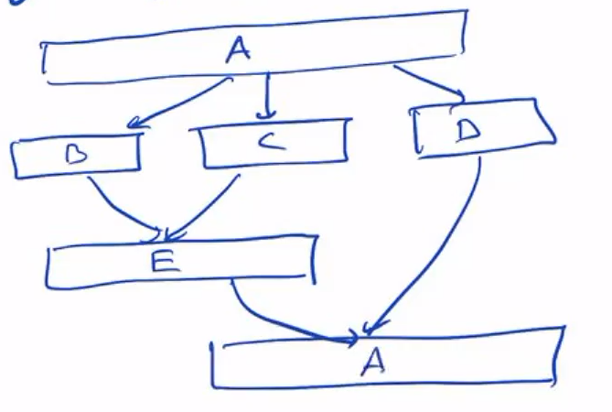
A. Levitin “Introduction to the Design & Analysis of Algorithms,” 3rd ed., Ch. 5 ©2012 Pearson Education, Inc. Upper Saddle River, NJ. All Rights Reserved.

Slide 12
Quicksort
Select a pivot (partitioning element) – here, the first element
Rearrange the list so that all the elements in the first s positions are smaller than or equal to the pivot and all the elements in the remaining n-s positions are larger than or equal to the pivot (see next slide for an algorithm)
Exchange the pivot with the last element in the first (i.e., ≤) subarray — the pivot is now in its final position
Sort the two subarrays recursively
p
A[i]≤p
A[i]≥p
A. Levitin “Introduction to the Design & Analysis of Algorithms,” 3rd ed., Ch. 5 ©2012 Pearson Education, Inc. Upper Saddle River, NJ. All Rights Reserved.

Slide 13
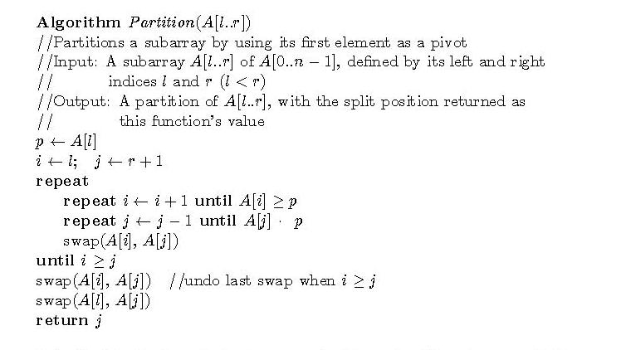
Hoare’s Partitioning Algorithm
A. Levitin “Introduction to the Design & Analysis of Algorithms,” 3rd ed., Ch. 5 ©2012 Pearson Education, Inc. Upper Saddle River, NJ. All Rights Reserved.

Slide 14
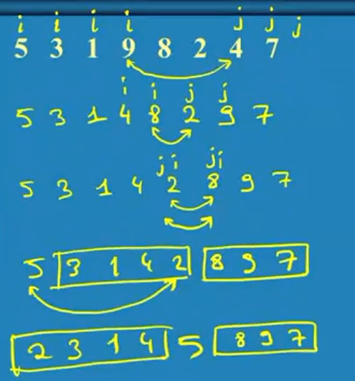

Quicksort Example
5 3 1 9 8 2 4 7
A. Levitin “Introduction to the Design & Analysis of Algorithms,” 3rd ed., Ch. 5 ©2012 Pearson Education, Inc. Upper Saddle River, NJ. All Rights Reserved.

Slide 15
Analysis of Quicksort
Best case: split in the middle — Θ(n log n)
Worst case: sorted array! — Θ(n²)
Average case: random arrays — Θ(n log n)
Improvements:
  better pivot selection: median of three partitioning
  switch to insertion sort on small subfiles
  elimination of recursion
  These combine to 20-25% improvement
Considered the method of choice for internal sorting of large files (n ≥ 10000)
A. Levitin “Introduction to the Design & Analysis of Algorithms,” 3rd ed., Ch. 5 ©2012 Pearson Education, Inc. Upper Saddle River, NJ. All Rights Reserved.

Slide 16
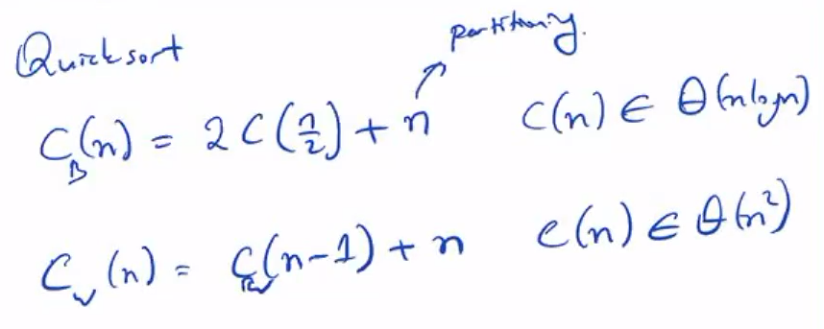
Analysis of Quicksort
A. Levitin “Introduction to the Design & Analysis of Algorithms,” 3rd ed., Ch. 5 ©2012 Pearson Education, Inc. Upper Saddle River, NJ. All Rights Reserved.

Slide 17
Binary Tree Algorithms
Binary tree is a divide-and-conquer ready structure!
Ex. 1: Classic traversals (preorder, inorder, postorder)
Algorithm Inorder(T)
if T ≠ ∅ a a
Inorder(T_{left}) b c b c
print(root of T) d e   d e
Inorder(T_{right})    
Efficiency: Θ(n)
A. Levitin “Introduction to the Design & Analysis of Algorithms,” 3rd ed., Ch. 5 ©2012 Pearson Education, Inc. Upper Saddle River, NJ. All Rights Reserved.

Slide 18
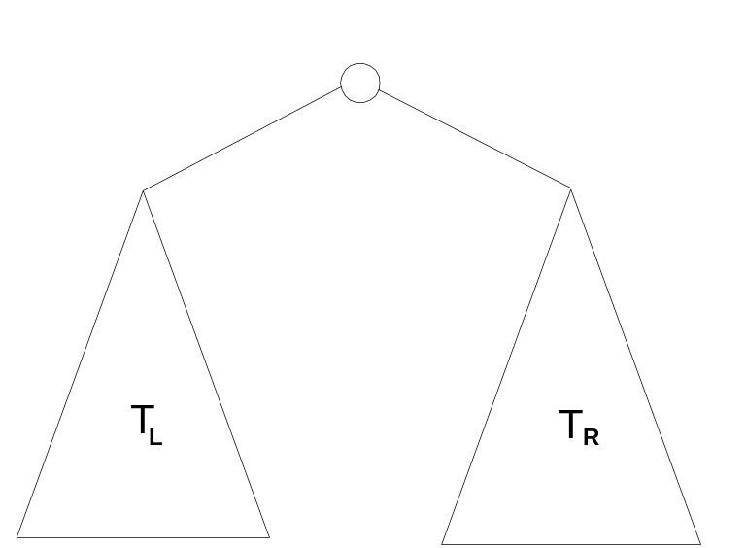
Binary Tree Algorithms (cont.)
Ex. 2: Computing the height of a binary tree
h(T) = max{h(T_{L}), h(T_{R})} + 1 if T ≠ ∅ and h(∅) = -1
Efficiency: Θ(n)
A. Levitin “Introduction to the Design & Analysis of Algorithms,” 3rd ed., Ch. 5 ©2012 Pearson Education, Inc. Upper Saddle River, NJ. All Rights Reserved.

Slide 19
Multiplication of Large Integers
Consider the problem of multiplying two (large) n-digit integers represented by arrays of their digits such as:
A = 12345678901357986429 B = 87654321284820912836
The grade-school algorithm:
a₁ a₂ … a_{n}
b₁ b₂ … b_{n}
(d₁₀) d₁₁d₁₂ … d_{1n}
(d₂₀) d₂₁d₂₂ … d_{2n}
… … … … … … …
(d_{n0}) d_{n1}d_{n2} … d_{nn}
Efficiency: n² one-digit multiplications
A. Levitin “Introduction to the Design & Analysis of Algorithms,” 3rd ed., Ch. 5 ©2012 Pearson Education, Inc. Upper Saddle River, NJ. All Rights Reserved.

Slide 20
First Divide-and-Conquer Algorithm
A small example: A ∗ B where A = 2135 and B = 4014
A = (21·10² + 35), B = (40 ·10² + 14)
So, A ∗ B = (21 ·10² + 35) ∗ (40 ·10² + 14)
= 21 ∗ 40 ·10⁴ + (21 ∗ 14 + 35 ∗ 40) ·10² + 35 ∗ 14
In general, if A = A₁A₂ and B = B₁B₂ (where A and B are n-digit,
A₁, A₂, B₁, B₂ are n/2-digit numbers),
A ∗ B = A₁ ∗ B₁·10^{n} + (A₁ ∗ B₂ + A₂ ∗ B₁) ·10^{n/2} + A₂ ∗ B₂
Recurrence for the number of one-digit multiplications M(n):
M(n) = 4M(n/2), M(1) = 1
Solution: M(n) = n²
A. Levitin “Introduction to the Design & Analysis of Algorithms,” 3rd ed., Ch. 5 ©2012 Pearson Education, Inc. Upper Saddle River, NJ. All Rights Reserved.

Slide 21
Second Divide-and-Conquer Algorithm
A ∗ B = A₁ ∗ B₁·10^{n} + (A₁ ∗ B₂ + A₂ ∗ B₁) ·10^{n/2} + A₂ ∗ B₂
The idea is to decrease the number of multiplications from 4 to 3:
(A₁ + A₂ ) ∗ (B₁ + B₂ ) = A₁ ∗ B₁ + (A₁ ∗ B₂ + A₂ ∗ B₁) + A₂ ∗ B_{2,}
I.e., (A₁ ∗ B₂ + A₂ ∗ B₁) = (A₁ + A₂ ) ∗ (B₁ + B₂ ) - A₁ ∗ B₁ - A₂ ∗ B_{2,}
which requires only 3 multiplications at the expense of (4-1) extra add/sub.
Recurrence for the number of multiplications M(n):
M(n) = 3M(n/2), M(1) = 1
Solution: M(n) = 3^{log 2n} = n^{log 23} ≈ n^{1.585}
A. Levitin “Introduction to the Design & Analysis of Algorithms,” 3rd ed., Ch. 5 ©2012 Pearson Education, Inc. Upper Saddle River, NJ. All Rights Reserved.

Slide 22
Example of Large-Integer Multiplication
2135 ∗ 4014
A. Levitin “Introduction to the Design & Analysis of Algorithms,” 3rd ed., Ch. 5 ©2012 Pearson Education, Inc. Upper Saddle River, NJ. All Rights Reserved.

Slide 23
Strassen’s Matrix Multiplication
Strassen observed [1969] that the product of two matrices can be computed as follows:
    C₀₀ C₀₁ A₀₀ A₀₁ B₀₀ B₀₁
    = *
    C₁₀ C₁₁ A₁₀ A₁₁ B₁₀ B₁₁
    M₁ + M₄ - M₅ + M₇ M₃ + M₅
    =
    M₂ + M₄ M₁ + M₃ - M₂ + M₆
A. Levitin “Introduction to the Design & Analysis of Algorithms,” 3rd ed., Ch. 5 ©2012 Pearson Education, Inc. Upper Saddle River, NJ. All Rights Reserved.

Slide 24
Formulas for Strassen’s Algorithm
M₁ = (A₀₀ + A₁₁) ∗ (B₀₀ + B₁₁)
M₂ = (A₁₀ + A₁₁) ∗ B₀₀
M₃ = A₀₀ ∗ (B₀₁ - B₁₁)
M₄ = A₁₁ ∗ (B₁₀ - B₀₀)
M₅ = (A₀₀ + A₀₁) ∗ B₁₁
M₆ = (A₁₀ - A₀₀) ∗ (B₀₀ + B₀₁)
M₇ = (A₀₁ - A₁₁) ∗ (B₁₀ + B₁₁)
A. Levitin “Introduction to the Design & Analysis of Algorithms,” 3rd ed., Ch. 5 ©2012 Pearson Education, Inc. Upper Saddle River, NJ. All Rights Reserved.

Slide 25
Analysis of Strassen’s Algorithm
If n is not a power of 2, matrices can be padded with zeros.
Number of multiplications:
M(n) = 7M(n/2), M(1) = 1
Solution: M(n) = 7^{log 2n} = n^{log 27} ≈ n^{2.807} vs. n³ of brute-force alg.
Algorithms with better asymptotic efficiency are known but they
are even more complex.
A. Levitin “Introduction to the Design & Analysis of Algorithms,” 3rd ed., Ch. 5 ©2012 Pearson Education, Inc. Upper Saddle River, NJ. All Rights Reserved.

Slide 26
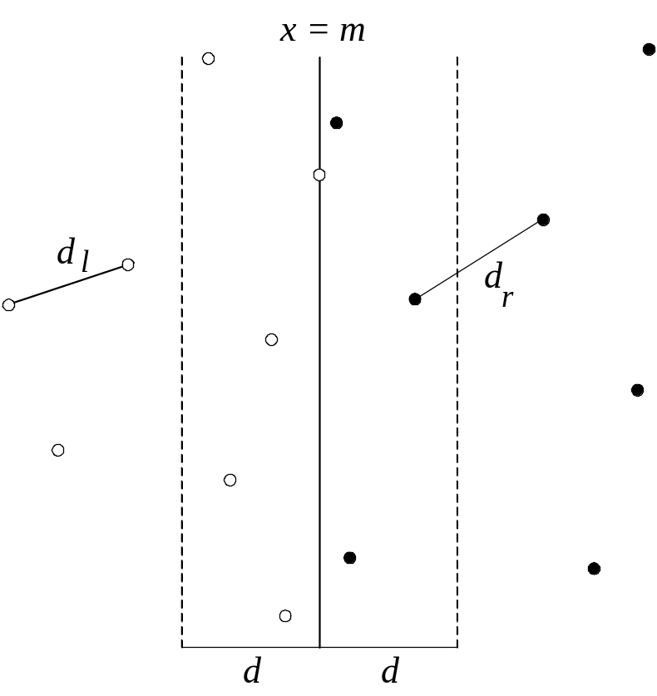
Closest-Pair Problem by Divide-and-Conquer
Step 1 Divide the points given into two subsets P_{l} and P_{r} by a vertical line x = m so that half the points lie to the left or on the line and half the points lie to the right or on the line.
A. Levitin “Introduction to the Design & Analysis of Algorithms,” 3rd ed., Ch. 5 ©2012 Pearson Education, Inc. Upper Saddle River, NJ. All Rights Reserved.

Slide 27
Closest Pair by Divide-and-Conquer (cont.)
Step 2 Find recursively the closest pairs for the left and right
subsets.
Step 3 Set d = min{d_{l}, d_{r}}
We can limit our attention to the points in the symmetric
vertical strip S of width 2d as possible closest pair. (The
points are stored and processed in increasing order of
their y coordinates.)
Step 4 Scan the points in the vertical strip S from the lowest up.
For every point p(x,y) in the strip, inspect points in
in the strip that may be closer to p than d. There can be
no more than 5 such points following p on the strip list!
A. Levitin “Introduction to the Design & Analysis of Algorithms,” 3rd ed., Ch. 5 ©2012 Pearson Education, Inc. Upper Saddle River, NJ. All Rights Reserved.
Notes:
Unfortunately, d is not necessarily the smallest distance between all pairs of points in S1 and
S2 because a closer pair of points can lie on the opposite sides separating the line. When we
combine the two sets, we must examine such points. (Illustrate this on the diagram)

Slide 28
Efficiency of the Closest-Pair Algorithm
Running time of the algorithm is described by
T(n) = 2T(n/2) + M(n), where M(n) ∈ O(n)
By the Master Theorem (with a = 2, b = 2, d = 1)
T(n) ∈ O(n log n)
A. Levitin “Introduction to the Design & Analysis of Algorithms,” 3rd ed., Ch. 5 ©2012 Pearson Education, Inc. Upper Saddle River, NJ. All Rights Reserved.

Slide 29
Quickhull Algorithm
Convex hull: smallest convex set that includes given points
Assume points are sorted by x-coordinate values
Identify extreme points P₁ and P₂ (leftmost and rightmost)
Compute upper hull recursively:
  find point P_{max} that is farthest away from line P₁P₂
  compute the upper hull of the points to the left of line P₁P_{max}
  compute the upper hull of the points to the left of line P_{max}P₂
Compute lower hull in a similar manner
P_{max}
P₂
P₁
A. Levitin “Introduction to the Design & Analysis of Algorithms,” 3rd ed., Ch. 5 ©2012 Pearson Education, Inc. Upper Saddle River, NJ. All Rights Reserved.

Slide 30
Efficiency of Quickhull Algorithm
Finding point farthest away from line P₁P₂ can be done in linear time
Time efficiency:
  worst case: Θ(n²) (as quicksort)
  average case: Θ(n) (under reasonable assumptions about
  distribution of points given)
If points are not initially sorted by x-coordinate value, this can be accomplished in O(n log n) time
Several O(n log n) algorithms for convex hull are known
A. Levitin “Introduction to the Design & Analysis of Algorithms,” 3rd ed., Ch. 5 ©2012 Pearson Education, Inc. Upper Saddle River, NJ. All Rights Reserved.

